Slide 1

Amazon Sales Data Analysis
By
Elizabeth

Slide 2

Problem Statement
Sales management has gained importance to meet increasing competition and the need for improved methods of distribution to reduce cost and to increase profits. Sales management today is the most important function in a commercial and business enterprise.
Find key metrics and factors and show the meaningful relationships between attributes. Do your own research and come up with your findings.

Slide 3


Dashboard
Amazon Sales Data analysis

Slide 4
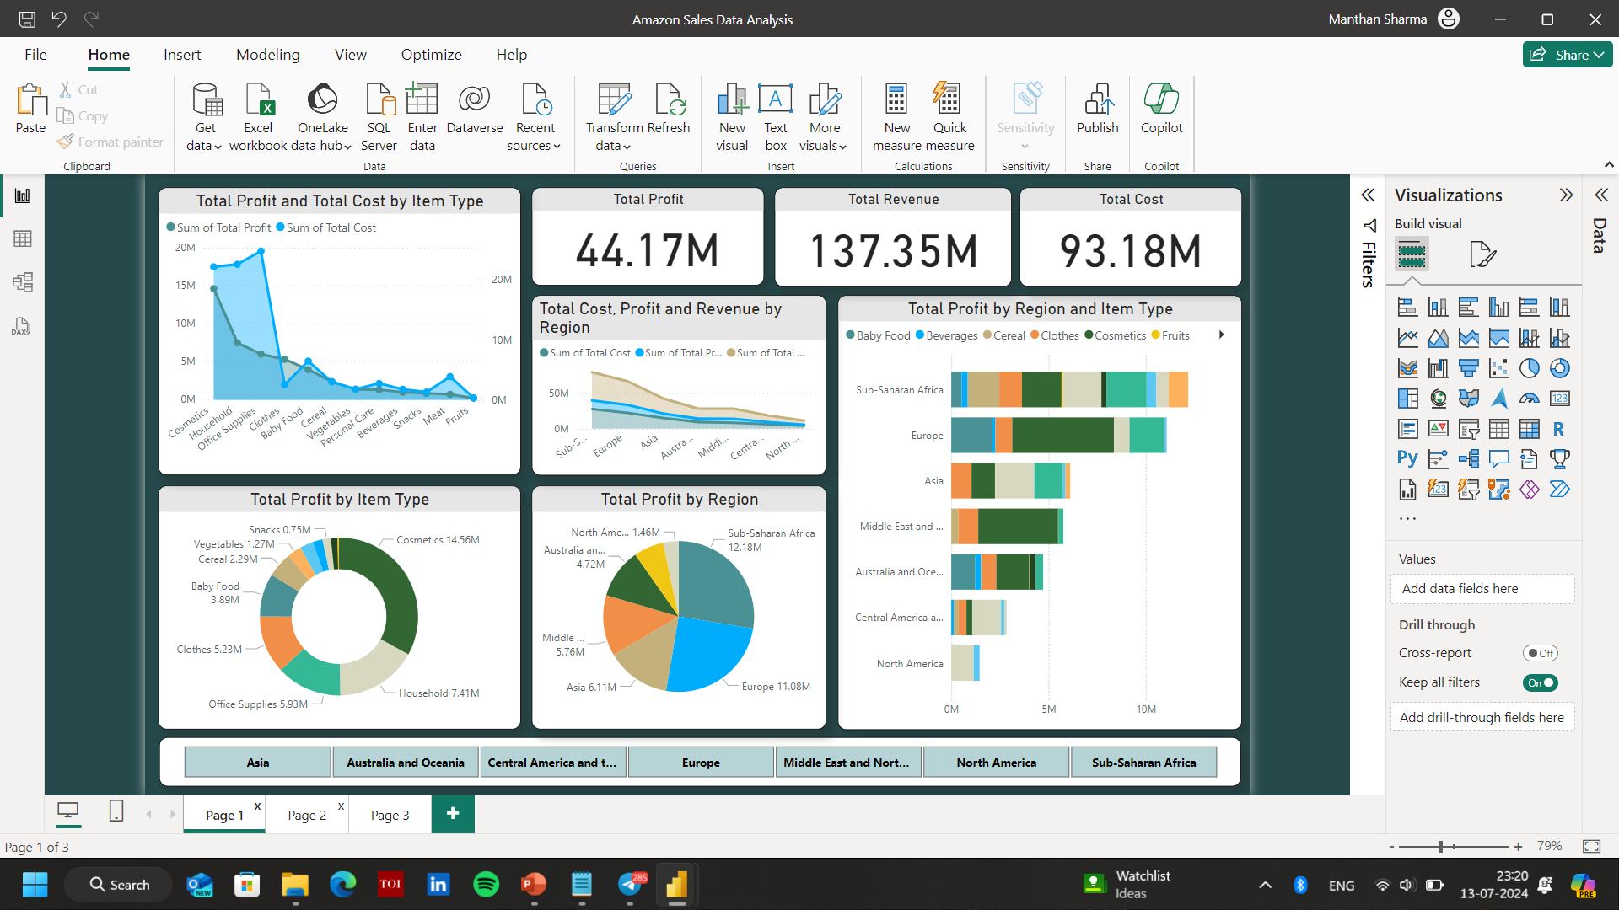
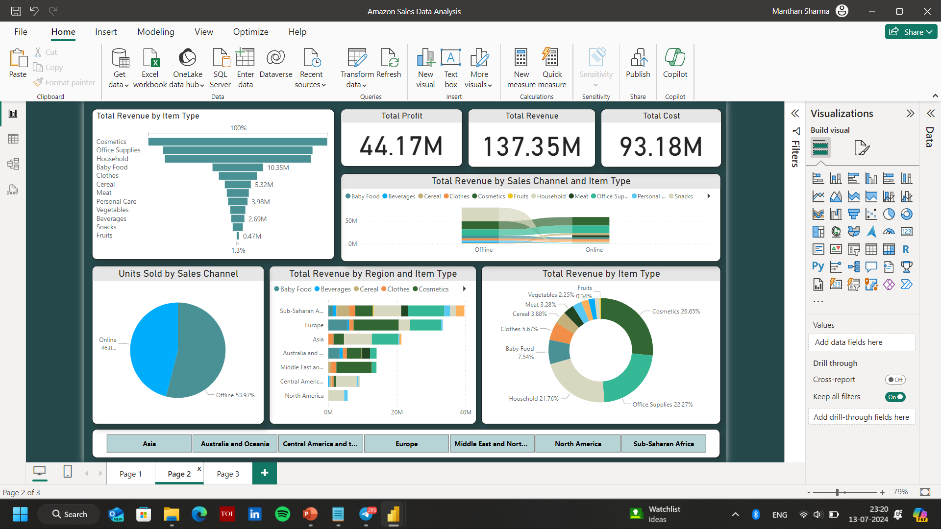
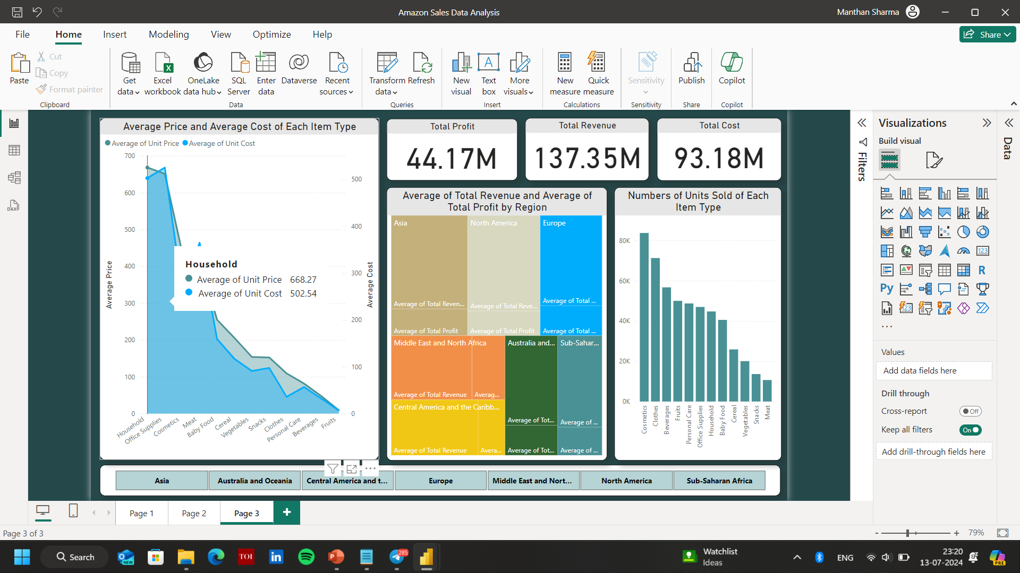
Dashboards

Slide 5
Analysis From Dashboard 1
Cosmetics had the highest profit of $14.56 millions among all the items, which accounted for 32.96% of total profit, while fruits lies at the lowest of all the items with an amount of only $120,000.
Profit and Cost values are positively corelated with each other.
Total profit and Total cost values diverged the most for the “Office Supplies” item, where cost was $18.72 millions higher than the profit.

Slide 6
Analysis From Dashboard 2
A total of 512,871 sales were made, out of which 276782 were sold offline and was higher than the online sales which made a total count of 236089.
Out of the total sales, 53.97% items were sold offline, while the rest were sold online.
“Household” items made up 21.62% of the Total Revenue in the sales.

Slide 7
Analysis From Dashboard 3
The “Household” item type has the highest Average Unit Price of $668.27. On the other hand, the “Fruits” item type has the lowest Unit Price of $9.33.
Average of Unit Prize and Total Average of Unit Cost are positively correlated to each other.
Average Unit Price and Average Unit Cost diverged most when the item type was “Cosmetics”. The Average Price being $173.87 higher than the Average Unit Cost.
Across all the 12 items, “Cosmetics” accounted for 16.32% of the Total Units Sold.

Slide 8


Conclusion
Out of the total sales, 53.97% items were sold offline, while the rest were sold online. “Household” items made up 21.62% of the Total Revenue in the sales.
Across all the 12 items, “Cosmetics” accounted for 16.32% of the Total Units Sold.
It had the highest profit of $14.56 millions among all the items, which accounted for 32.96% of total profit,

Slide 9




Thank you
ar.Elizabeth.tessa@gmail.com

